Slide 1
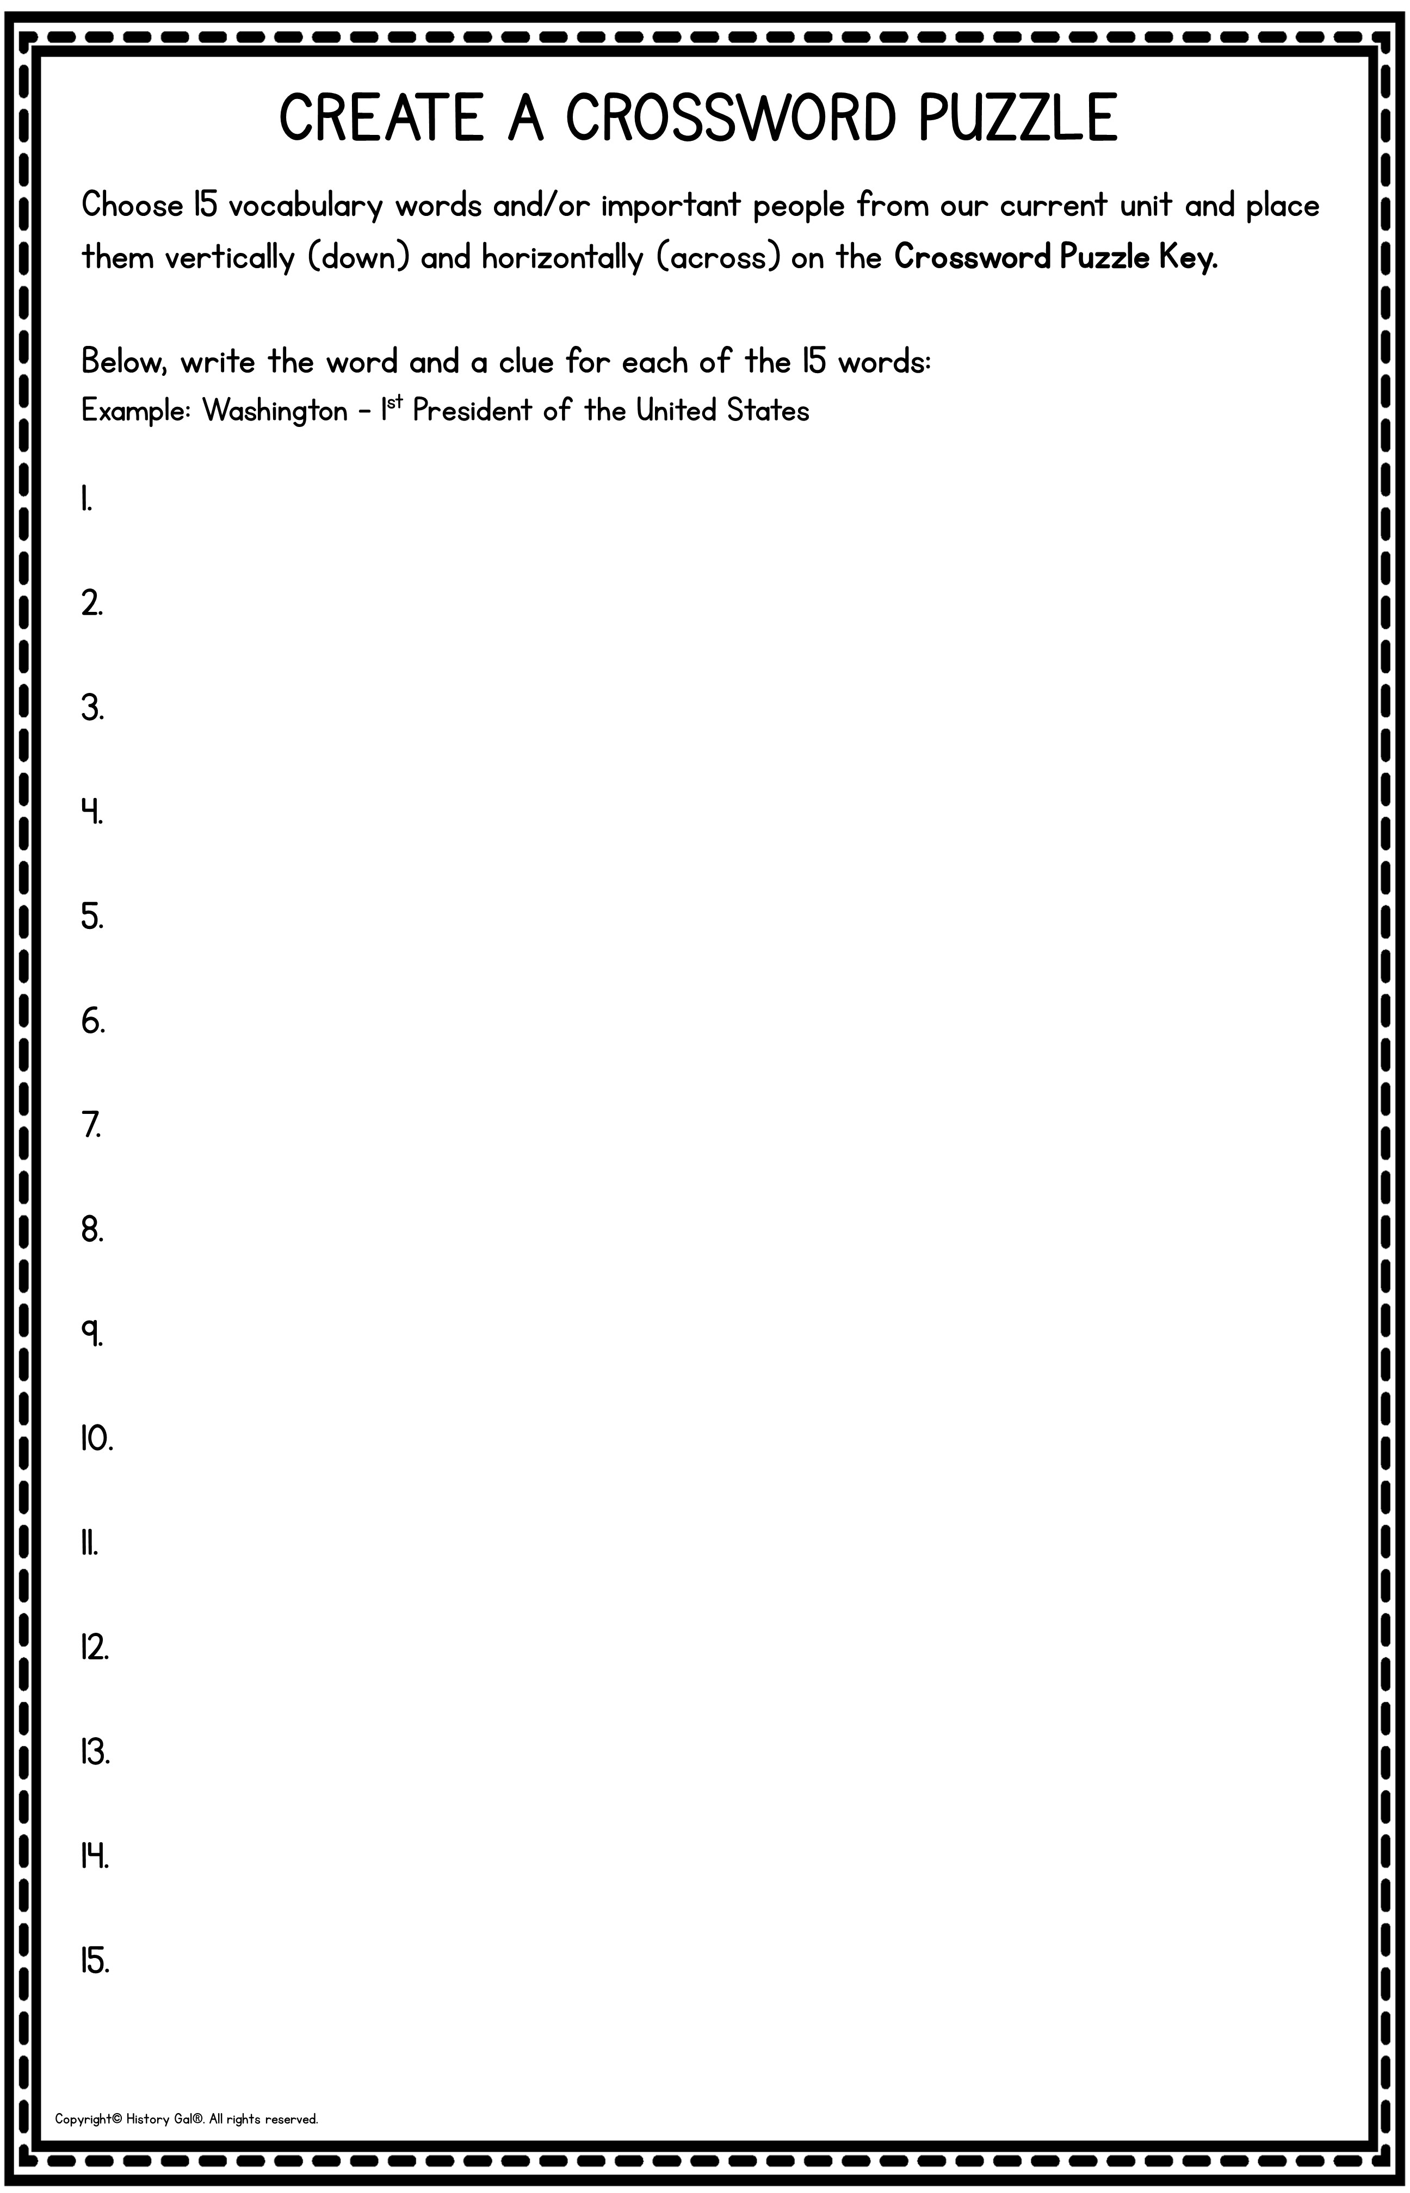
Type vocabulary word and definition here
Type vocabulary word and definition here
Type vocabulary word and definition here
Type vocabulary word and definition here
Type vocabulary word and definition here
Type vocabulary word and definition here
Type vocabulary word and definition here
Type vocabulary word and definition here
Type vocabulary word and definition here
Type vocabulary word and definition here
Type vocabulary word and definition here
Type vocabulary word and definition here
Type vocabulary word and definition here
Type vocabulary word and definition here
Type vocabulary word and definition here

Slide 2
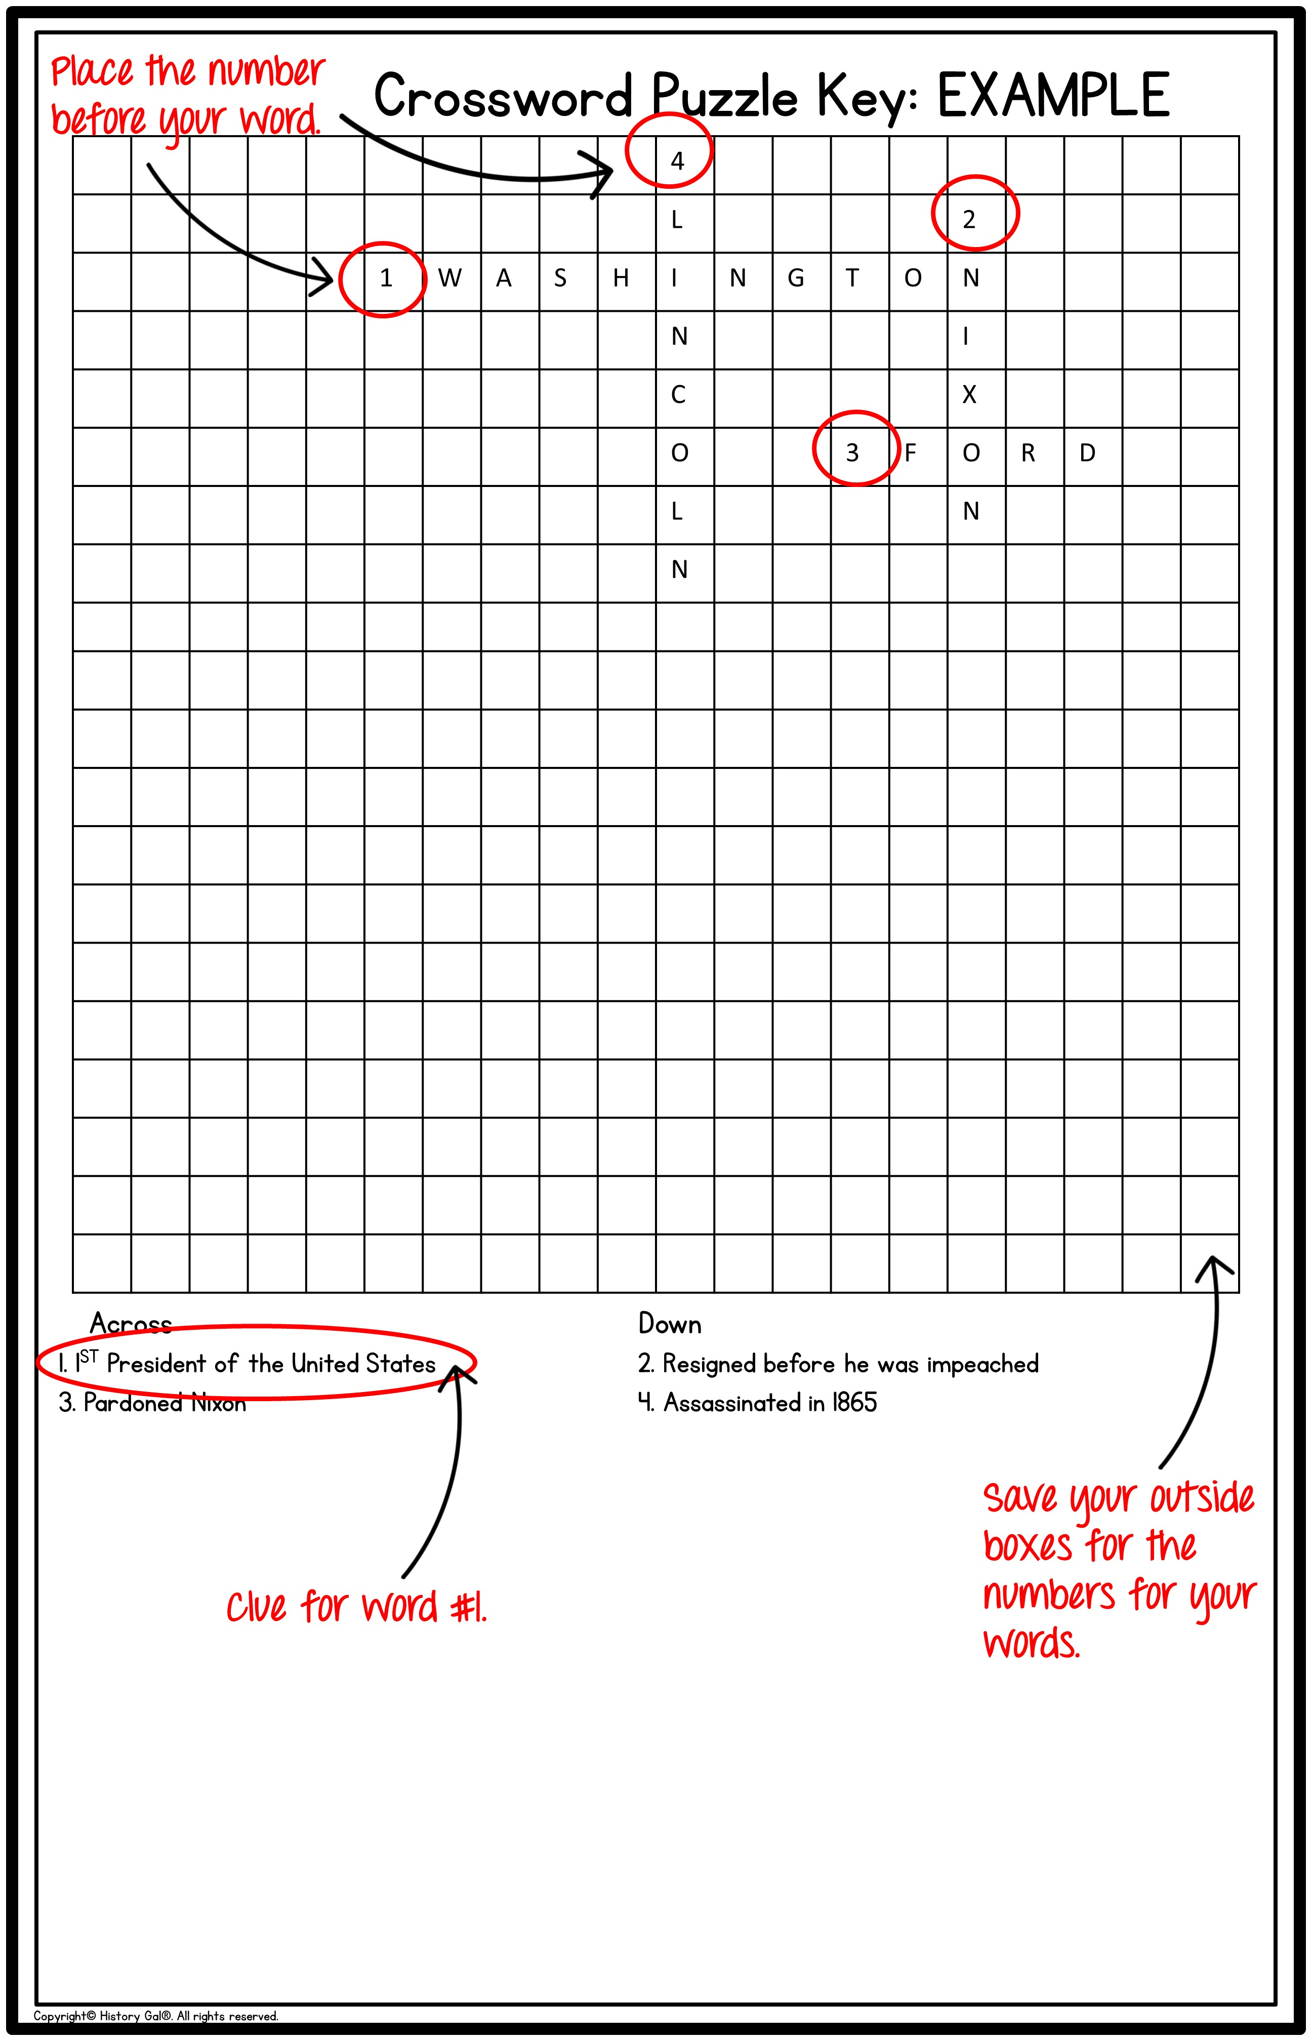

Slide 3

Click in the boxes to add each letter for your words. Once you have all of your words added, number each word 1-15 (type the number in the box before your word). You may highlight and shade the boxes not used.
In the Across and Down columns, write the word’s number followed by the clue.
Clue
Clue
Clue
Clue
Clue
Clue
Clue
8. Clue
9. Clue
10. Clue
11. Clue
12. Clue
13. Clue
14. Clue
15. Clue
*change the numbers as needed

